Slide 1
Algorithm and it Characteristics
A finite set of instruction that specifies a sequence of operation is to be carried out in order to solve a specific problem or class of problems is called an Algorithm.
Input: It should externally supply zero or more quantities.
Output: It results in at least one quantity.
Definiteness: Each instruction should be clear and ambiguous.
Finiteness: An algorithm should terminate after executing a finite number of steps.

Slide 2
Effectiveness: Every instruction should be fundamental to be carried out, in principle, by a person using only pen and paper.
Feasible: It must be feasible enough to produce each instruction.
Flexibility: It must be flexible enough to carry out desired changes with no efforts.

Slide 3
Efficient: The term efficiency is measured in terms of time and space required by an algorithm to implement. Thus, an algorithm must ensure that it takes little time and less memory space meeting the acceptable limit of development time.
Independent: An algorithm must be language independent, which means that it should mainly focus on the input and the procedure required to derive the output instead of depending upon the language.

Slide 4
Pseudocode
Pseudocode refers to an informal high-level description of the operating principle of a computer program or other algorithm.
It uses structural conventions of a standard programming language intended for human reading rather than the machine reading.

Slide 5
Pseudo Approach: Problem: Suppose there are 60 students in the class. How will you calculate the number of absentees in the class?
Initialize a variable called as Count to zero, absent to zero, total to 60
FOR EACH Student PRESENT DO the following:
Increase the Count by One
Then Subtract Count from total and store the result in absent
Display the number of absent students

Slide 6
Algorithmic Approach:
Count <- 0, absent <- 0, total <- 60
REPEAT till all students counted
Count <- Count + 1
absent <- total - Count
Print "Number absent is:" , absent

Slide 7
Need of Algorithm
To understand the basic idea of the problem.
To find an approach to solve the problem.
To improve the efficiency of existing techniques.
To understand the basic principles of designing the algorithm.
To compare the performance of the algorithm with respect to other techniques.
It is the best method of description without describing the implementation detail.

Slide 8
Analysis of algorithm
The analysis is a process of estimating the efficiency of an algorithm. There are two fundamental parameters based on which we can analysis the algorithm:
Space Complexity: The space complexity can be understood as the amount of space required by an algorithm to run to completion.
Time Complexity: Time complexity is a function of input size n that refers to the amount of time needed by an algorithm to run to completion.

Slide 9
Types of analysis
Worst-case time complexity:
For 'n' input size, the worst-case time complexity can be defined as the maximum amount of time needed by an algorithm to complete its execution.
Thus, it is nothing but a function defined by the maximum number of steps performed on an instance having an input size of n.

Slide 10
Average case time complexity:
For 'n' input size, the average-case time complexity can be defined as the average amount of time needed by an algorithm to complete its execution.
Thus, it is nothing but a function defined by the average number of steps performed on an instance having an input size of n.

Slide 11
Best case time complexity: For 'n' input size, the best-case time complexity can be defined as the minimum amount of time needed by an algorithm to complete its execution.
Thus, it is nothing but a function defined by the minimum number of steps performed on an instance having an input size of n.

Slide 12
Complexity of Algorithm
The term algorithm complexity measures how many steps are required by the algorithm to solve the given problem.
It evaluates the order of count of operations executed by an algorithm as a function of input data size.
To assess the complexity, the order (approximation) of the count of operation is always considered instead of counting the exact steps.

Slide 13
O(f) notation represents the complexity of an algorithm, which is also termed as an Asymptotic notation or "Big O" notation.
Here the f corresponds to the function whose size is the same as that of the input data.
The complexity of the asymptotic computation O(f) determines in which order the resources such as CPU, time, memory, etc. are consumed by the algorithm

Slide 14
The complexity can be found in any form such as constant, logarithmic, linear, n*log(n), quadratic, cubic, exponential, etc.
It is nothing but the order of constant, logarithmic, linear and so on, the number of steps encountered for the completion of a particular algorithm.

Slide 15
Typical Complexities of an Algorithm
Constant Complexity:
It imposes a complexity of O(1).
It undergoes an execution of a constant number of steps like 1, 5, 10, etc. for solving a given problem.
The count of operations is independent of the input data size.

Slide 16
Logarithmic Complexity:
It imposes a complexity of O(log(N)).
It undergoes the execution of the order of log(N) steps.
To perform operations on N elements, it often takes the logarithmic base as 2.
For N = 1,000,000, an algorithm that has a complexity of O(log(N)) would undergo 20 steps (with a constant precision).

Slide 17
Linear Complexity
It imposes a complexity of O(N).
It encompasses the same number of steps as that of the total number of elements to implement an operation on N elements.
For example, if there exist 500 elements, then it will take about 500 steps.
Basically, in linear complexity, the number of elements linearly depends on the number of steps.

Slide 18
It also imposes a run time of O(n*log(n)).
It undergoes the execution of the order N*log(N) on N number of elements to solve the given problem.
For a given 1000 elements, the linear complexity will execute 10,000 steps for solving a given problem.

Slide 19
Quadratic Complexity
It imposes a complexity of O(n²).
For N input data size, it undergoes the order of N2 count of operations on N number of elements for solving a given problem.
If N = 100, it will endure 10,000 steps. In other words, whenever the order of operation tends to have a quadratic relation with the input data size, it results in quadratic complexity.

Slide 20
Cubic Complexity:
It imposes a complexity of O(n³) .
For N input data size, it executes the order of N3 steps on N elements to solve a given problem.
For example, if there exist 100 elements, it is going to execute 1,000,000 step

Slide 21
Exponential Complexity
It imposes a complexity of O(2^{n}), O(N!), O(n^{k}) ,….
For N elements, it will execute the order of count of operations that is exponentially dependable on the input data size.
For example, if N = 10, then the exponential function 2^{N} will result in 1024.
Similarly, if N = 20, it will result in 1048 576, and if N = 100, it will result in a number having 30 digits.
The exponential function N! grows even faster; for example, if N = 5 will result in 120. Likewise, if N = 10, it will result in 3,628,800 and so on.

Slide 22
How to approximate the time taken by the Algorithm?
Iterative Algorithm: In the iterative approach, the function repeatedly runs until the condition is met or it fails. It involves the looping construct.
Recursive Algorithm: In the recursive approach, the function calls itself until the condition is met. It integrates the branching structure.

Slide 23
it is worth noting that any program that is written in iteration could be written as recursion.
Likewise, a recursive program can be converted to iteration, making both of these algorithms equivalent to each other.
To analyze the iterative program, we have to count the number of times the loop is going to execute, whereas in the recursive program, we use recursive equations.
Function of F(n) in terms of F(n/2).

Slide 24
Suppose the program is neither iterative nor recursive.
In that case, it can be concluded that there is no dependency of the running time on the input data size, i.e., whatever is the input size, the running time is going to be a constant value.
Thus, for such programs, the complexity will be O(1).

Slide 25
Iterative Programs
Example1: In the first example, we have an integer i and a for loop running from i equals 1 to n. Now the question arises, how many times does the name get printed?
A()
{
int i;
for (i=1 to n)
printf("Edward");
}
Since i equals 1 to n, so the above program will print Edward, n number of times. Thus, the complexity will be O(n).

Slide 26
Example:2
A()
{
int i, j:
for (i=1 to n)
for (j=1 to n)
printf("Edward");
}
In this case, firstly, the outer loop will run n times, such that for each time, the inner loop will also run n times. Thus, the time complexity will be O(n²)..

Slide 27
Example:3
A()
{
i = 1; S = 1;
while (S<=n)
{
i++;
SS = S + i;
printf("Edward");
}
}
we have two variables; i, S and then we have while S<=n, which means S will start at 1, and the entire loop will stop whenever S value reaches a point where S becomes greater than n.

Slide 28
Initially; i=1, S=1
After 1st iteration; i=2, S=3
After 2nd iteration; i=3, S=6
After 3rd iteration; i=4, S=10 … and so on.
Since we don't know the value of n, so let's suppose it to be k.
Now, if we notice the value of S in the above case is increasing;
for i=1, S=1; i=2, S=3; i=3, S=6; i=4, S=10; …

Slide 29


Thus, it is nothing but a series of the sum of first n natural numbers, i.e., by the time i reaches k, the value of S will be k(k+1)/2.
To stop the loop, Complexity of Algorithm has to be greater than n,
and when we solve we will get >n.
it can be concluded that we get a complexity of O(√n) in this case.

Slide 30
Insertion Sort
Let's consider the example of cards to have a better understanding of the logic behind the insertion sort.
Suppose we have a set of cards in our hand, such that we want to arrange these cards in ascending order.
To sort these cards, we have a number of intuitive ways.
One such thing we can do is initially we can hold all of the cards in our left hand, and we can start taking cards one after other from the left hand, followed by building a sorted arrangement in the right hand.

Slide 31
Assuming the first card to be already sorted, we will select the next unsorted card.
If the unsorted card is found to be greater than the selected card, we will simply place it on the right side, else to the left side.
At any stage during this whole process, the left hand will be unsorted, and the right hand will be sorted.
we will sort the rest of the unsorted cards by placing them in the correct position.
At each iteration, the insertion algorithm places an unsorted element at its right place.

Slide 32
ALGORITHM: INSERTION SORT (A)
1. for j = 2 to A.length
2. key = A[j]
3. // Insert A[j] into the sorted sequence A[1.. j - 1]
4. i = j - 1
5. while i > 0 and A[i] > key
6. A[i + 1] = A[i]
7. ii = i -1
8. A[i + 1] = key

Slide 33
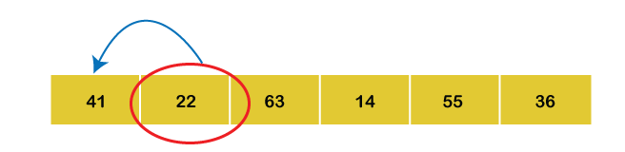
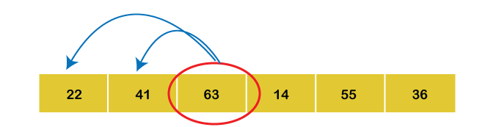
A = (41, 22, 63, 14, 55, 36) : Initially,
1st Iteration: Set key = 22 Compare a1 with a0 Since a0 > a1, swap both of them.
2nd Iteration: Set key = 63 Compare a2 with a1 and a0 : Since a2 > a1 > a0, keep the array as it is.

Slide 34
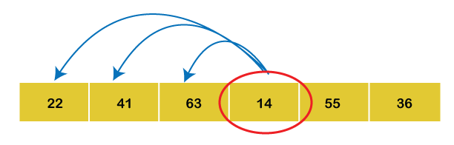

3rd Iteration: Set key = 14 Compare a3 with a2, a1 and a0 :
Since a3 is the smallest among all the elements on the left-hand side, place a3 at the beginning of the array.

Slide 35
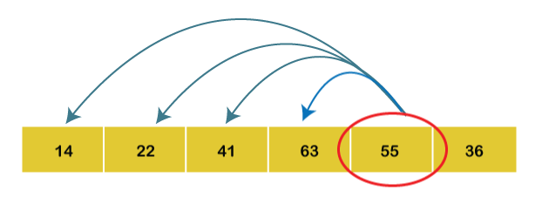

4th Iteration: Set key = 55 Compare a4 with a3, a2, a1 and a0.
As a4 < a3, swap both of them

Slide 36
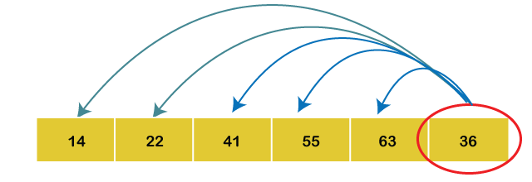

5th Iteration: Set key = 36 Compare a5 with a4, a3, a2, a1 and a0.
Since a5 < a2, so we will place the elements in their correct positions.
Hence the array is arranged in ascending order, so no more swapping is required.

Slide 37
Complexity Analysis of Insertion Sort
Input: Given n input elements.
Output: Number of steps incurred to sort a list.
Logic: If we are given n elements, then in the first pass, it will make n-1 comparisons; In the second pass, it will do n-2; In third pass, it will do n-3 and so on. Thus, the total number of comparisons can be found by; Output; (n-1) + (n-2) + (n-3) + (n-4) + ...... + 1 : Sum = O(n^2)
Therefore, the insertion sort algorithm encompasses a time complexity of O(n^2) and a space complexity of O(1) because it necessitates some extra memory space for a key variable to perform swap

Slide 38
Time Complexities:
Best Case Complexity: The insertion sort algorithm has a best-case time complexity of O(n) for the already sorted array because here, only the outer loop is running n times, and the inner loop is kept still.
Average Case Complexity: The average-case time complexity for the insertion sort algorithm is O(n^2), which is incurred when the existing elements are in jumbled order, i.e., neither in the ascending order nor in the descending order.

Slide 39
Worst Case Complexity: The worst-case time complexity is also O(n^2), which occurs when we sort the ascending order of an array into the descending order.
In this algorithm, every individual element is compared with the rest of the elements, due to which n-1 comparisons are made for every nth element.

Slide 40
Bubble Sort
Step 1 ➤ Initialization : set 1 ← n, p ← 1
Step 2 ➤ loop,
Repeat through step 4 while (p ≤ n-1)
set E ← 0 ➤ Initializing exchange variable
Step 3 ➤ comparison, loop.
Repeat for i ← 1, 1, …... l-1.
if (A [i] > A [i + 1]) then
set A [i] ↔ A [i + 1] ➤ Exchanging values.
Set E ← E + 1
Step 4 ➤ Finish, or reduce the size.
if (E = 0) then
exit
else
set l ← l - 1.

Slide 41
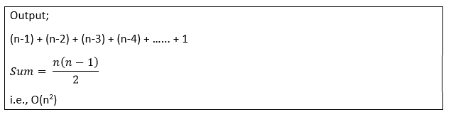
Complexity Analysis of Bubble Sort
Input: Given n input elements.
Output: Number of steps incurred to sort a list.
Logic: If we are given n elements, then in the first pass, it will do n-1 comparisons; in the second pass, it will do n-2; in the third pass, it will do n-3 and so on. Thus, the total number of comparisons can be found by;

Slide 42
Therefore, the bubble sort algorithm encompasses a time complexity of O(n^2) and a space complexity of O(1) because it necessitates some extra memory space for temp variable for swapping.

Slide 43
Time Complexities:
Best Case Complexity: The bubble sort algorithm has a best-case time complexity of O(n) for the already sorted array.
Average Case Complexity: The average-case time complexity for the bubble sort algorithm is O(n^2), which happens when 2 or more elements are in jumbled, i.e., neither in the ascending order nor in the descending order.
Worst Case Complexity: The worst-case time complexity is also O(n^2), which occurs when we sort the descending order of an array into the ascending order.

Slide 44
Asymptotic Notation
Asymptotic Notations are the expressions that are used to represent the complexity of an algorithm.
1. Big-O Notation (Ο) – Big O notation specifically describes worst case scenario. Big-O notation represents the upper bound of the running time of an algorithm
2. Omega Notation (Ω) – Omega(Ω) notation specifically describes best case scenario. lower bound of the running time of an algorithm
3. Theta Notation (θ) – This notation represents the average complexity of an algorithm. it represents the upper and the lower bound of the running time of an algorithm, it is used for analyzing the average-case complexity of an algorithm.

Slide 45
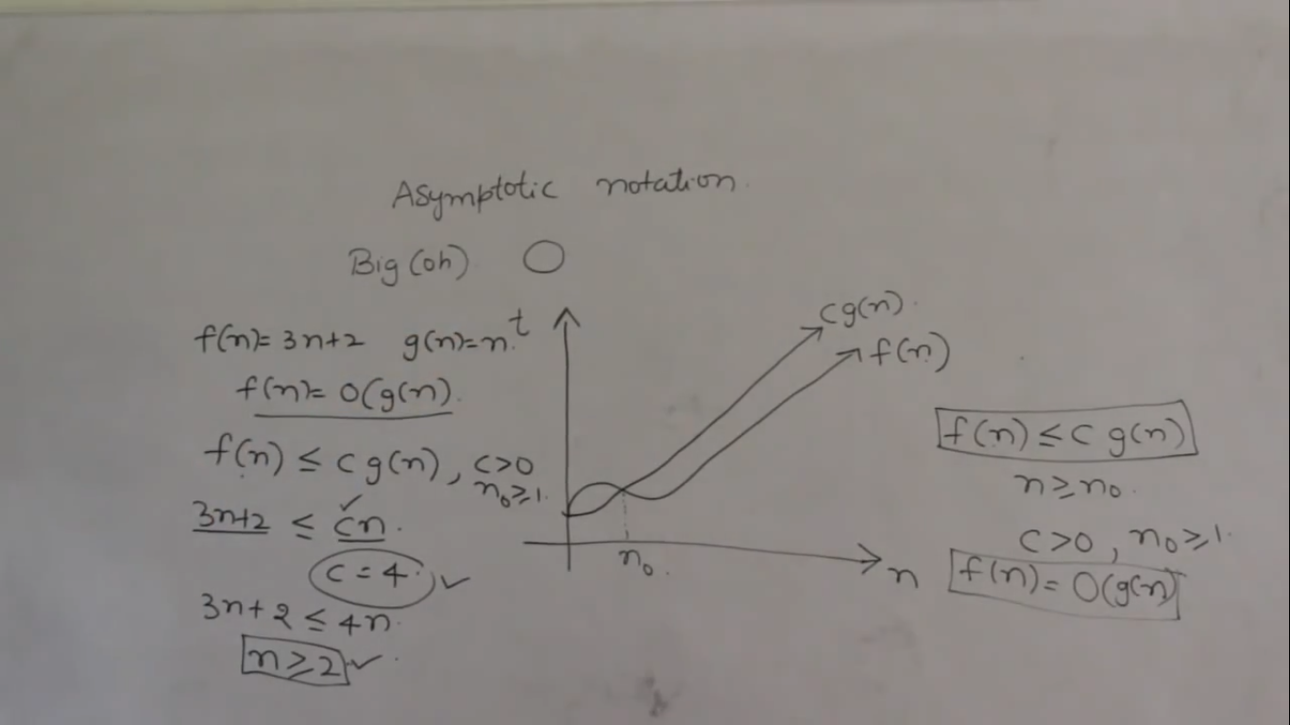

Slide 46
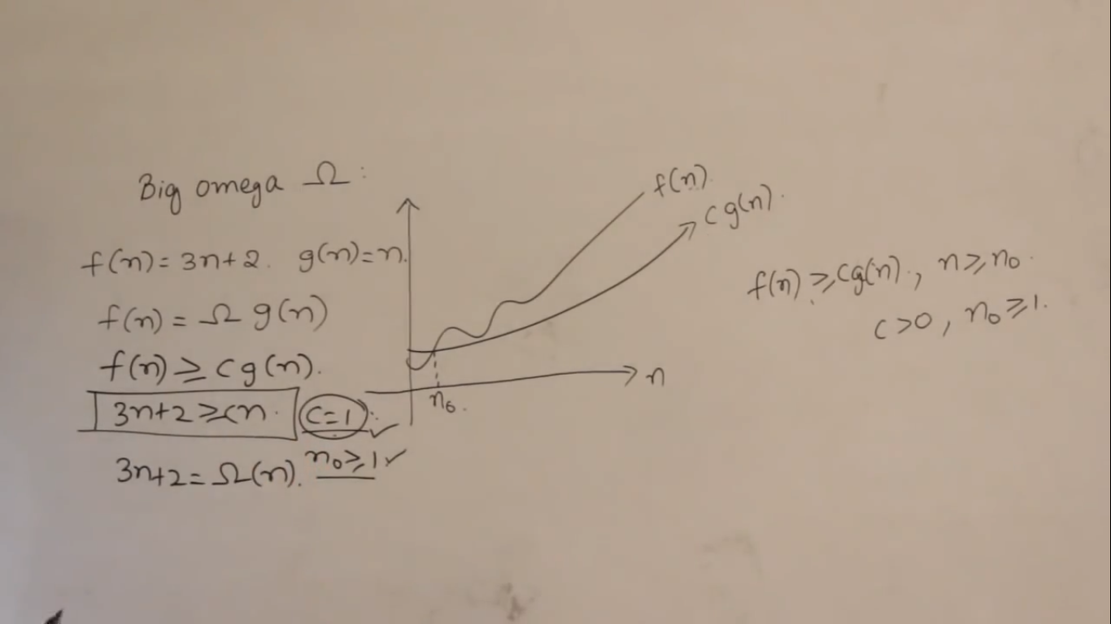

Slide 47
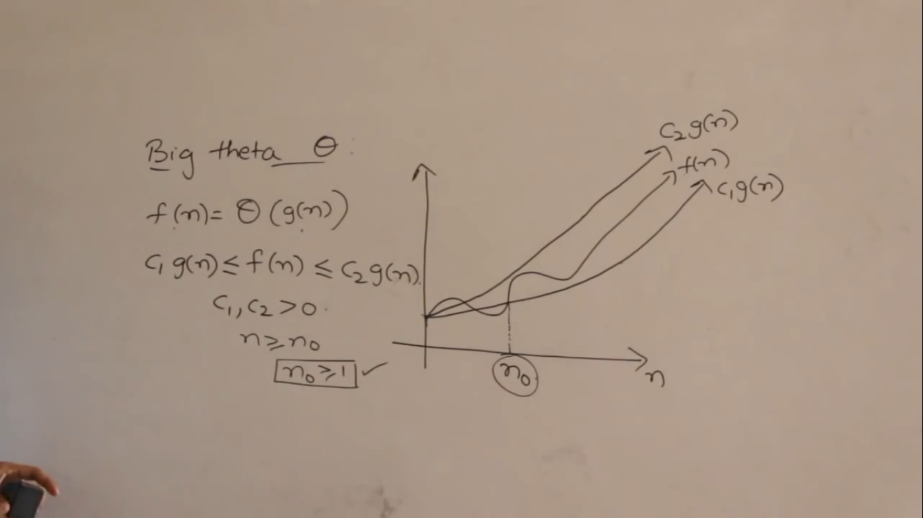

Slide 48
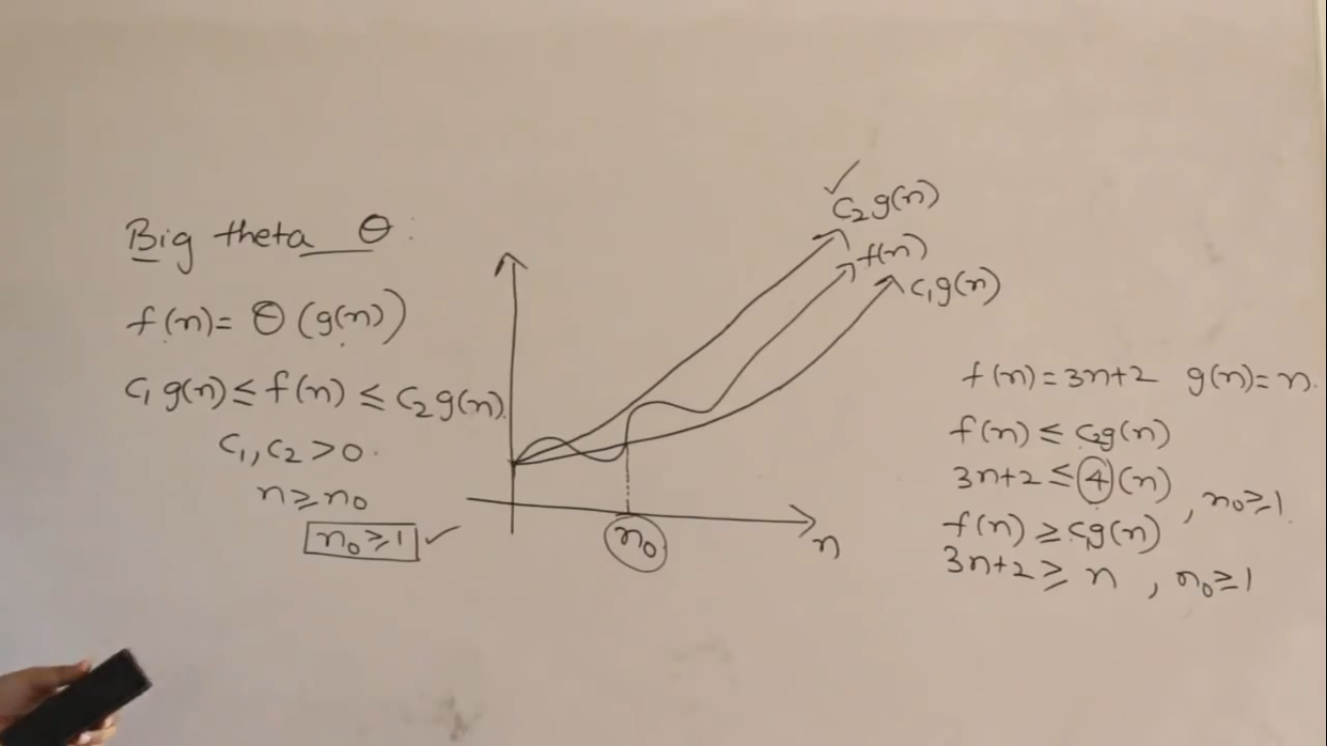

Slide 49
Big-O Notation (Ο)
Big O notation specifically describes worst case scenario. It represents the upper bound running time complexity of an algorithm. Lets take few examples to understand how we represent the time and space complexity using Big O notation.
O(1)
Big O notation O(1) represents the complexity of an algorithm that always execute in same time or space regardless of the input data.

Slide 50
O(1) example
The following step will always execute in same time(or space) regardless of the size of input data.
Accessing array index(int num = arr[5]
O(n)
Big O notation O(N) represents the complexity of an algorithm, whose performance will grow linearly (in direct proportion) to the size of the input data.

Slide 51
O(n) example
The execution time will depend on the size of array. When the size of the array increases, the execution time will also increase in the same proportion (linearly) Example :Traversing an array
O(n^2)
Big O notation O(n^2) represents the complexity of an algorithm, whose performance is directly proportional to the square of the size of the input data.
O(n^2) example : Traversing a 2D array

